Slide 1
Chapter 1: Pesticides

Slide 2
Pesticides
They are chemical or biological agents that are used for preventing, destroying, repelling or controlling any insects, rodents, nematodes, fungi or weeds. They serve as plant protection products which protects them from insects, rodents etc.

Slide 3
Classification of pesticides
They can be classified according to:
Their source.
Their target.
Their mode of action.
Their Chemical structure.

Slide 4
Based on their source
Natural pesticides:
Derived from natural source such as mineral or plants.
E.g. nicotine, rotenone, neem oil etc.
Synthetic pesticides:
They are man made and usually as made from poisonous chemicals.
E.g. Carbanates, organophosphates etc.

Slide 5
Based on targets
Insecticides: to specifically target and kill insects.
Herbicides: to kill undesirable plants and weeds.
Fungicides: to control and eradicate the fungi developing on fruits, vegetables and cereal crops.
Rodenticides: to kill rats and mice.
Nematicides: to kill plant-parasitic nematodes.

Slide 6
Based on their action
Stomach poison: taken up by insects e.g. DDT, BHC, lead arsenate.
Contact poison: destroy insects simply by body contact e.g. DDT, BHC, aldrin, melathion.
Fumigants: act on the insect through respiratory system e.g. HCN, nicotine, BHC, methyl bromide.
Systemic pesticides: absorbed bt the roots, stems and leaves of the plants. Insects are killed when they feed on these areas of the plant.

Slide 7
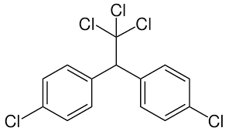
Based on Chemical Structure
1. Organochlorines
Very persistent in the environment
Affects non-target species
Effects nervous system
Removed from the market due to health effects
Examples include DDT

Slide 8
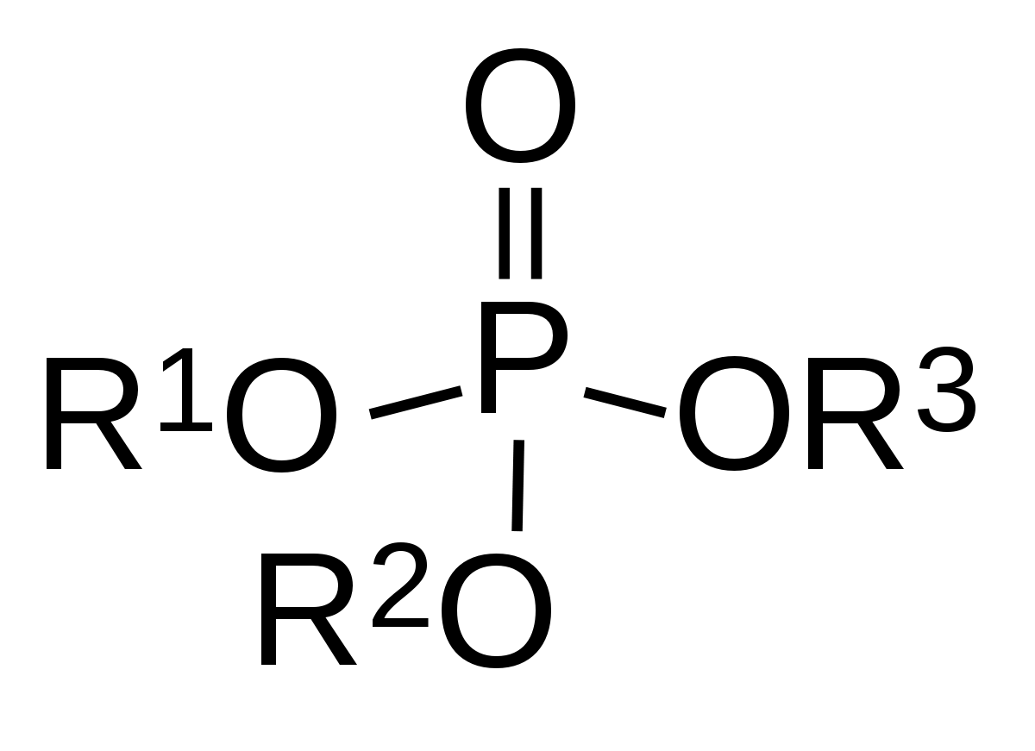
2. Organophosphates
Affects non-target species
Affect the nervous system
Effects are usually reversible
Highly toxic
Not as persistent in the environment

Slide 9
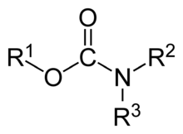
3. Carbamates
They are esters of carbamic acid. E.g. are carbofuran, carbaryl, ethienocarb etc.
4. Quinones
They are derivatives of benzoquinones.
They act as fungicides. E.g. chloranil, dichlone etc.
5. Anilides
They are acyl derivatives of aniline.
They are herbicides in action and are used to control growth of weeds in the crops.

Slide 10
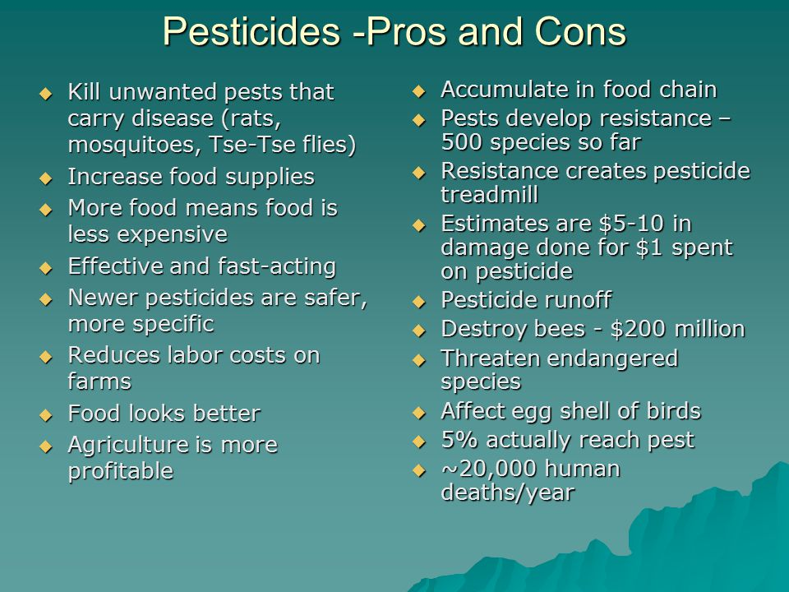

Slide 11
Thank You

